Slide 1
Reviewer for the final exams(analog part)
Read all the lecture slides carefully
Read the digital part home work questions and their resolutions(digital part)
Read the review for the digital part

Slide 2
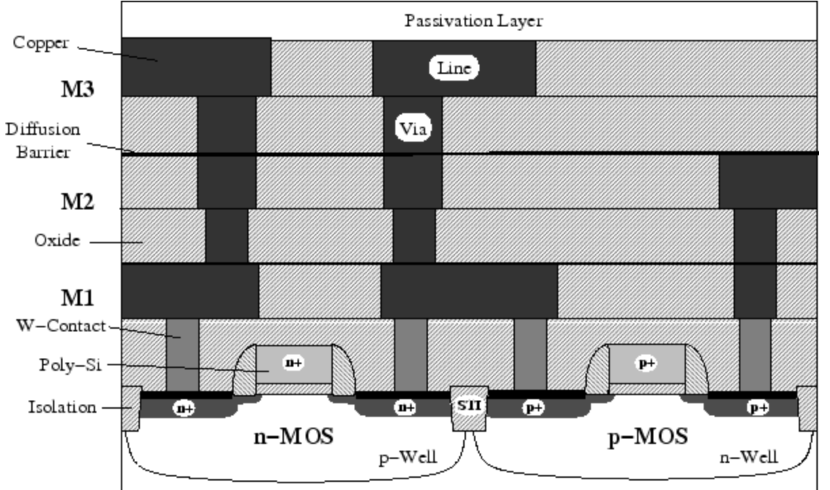
Transistor
n-MOS
p-MOS
W: Tungsten
AMI 0.6 mm process has 3 metal layers
STI: Shallow trench isolation
M1 for within-cell routing
M2 for vertical routing between cells
M3 for horizontal routing between cells

Slide 3
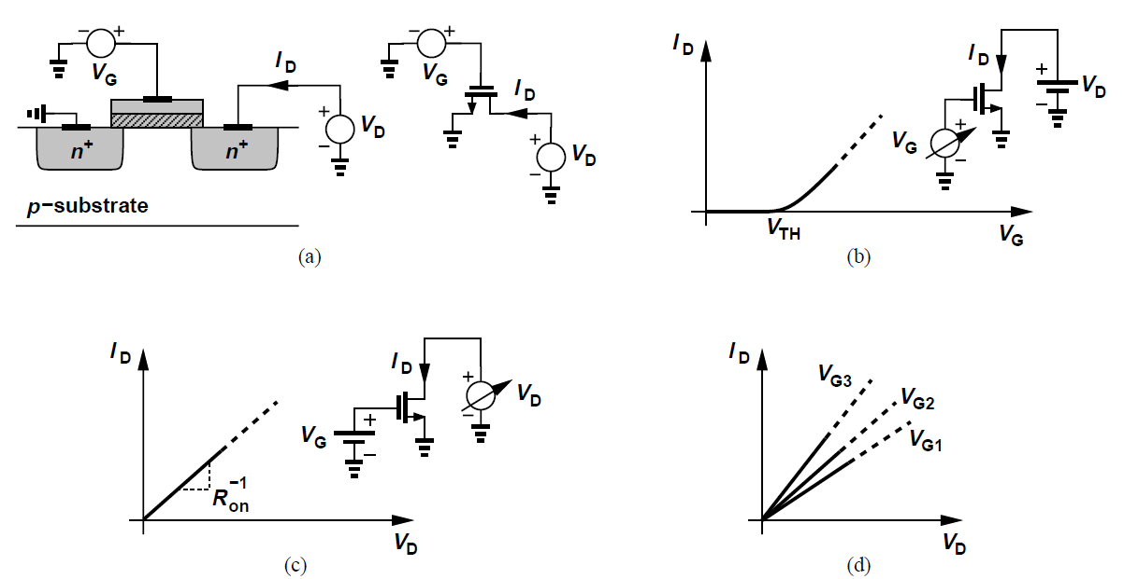
Transistor: NMOS
VDS <<2(VGS − VTH),
Deep triode region
V_{G}=V_{TH}
overdrive voltage: V_{GS} − V_{TH}
With the condition, VDS <<2(VGS − VTH), we say the device operates in the deep triode region.

Slide 4





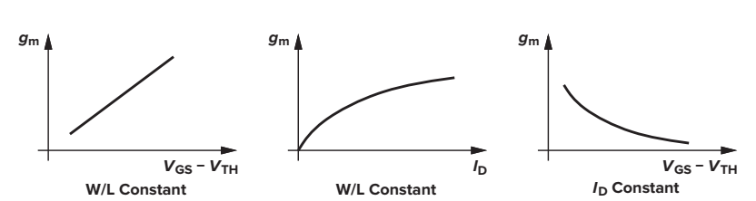
Small signal models
[in saturation]
gm represents the sensitivity of the device: for a high gm, a small change in VGS results in a large change in ID.

Slide 5



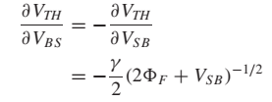
Small signal models
η = gmb/gm and is typically around 0.25.
Owing to channel-length modulation, the drain current also varies with the drain-source voltage
The bulk potential influences the threshold voltage and hence the gate-source overdrive

Slide 6
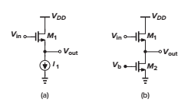
Complete MOS small-signal

Slide 7
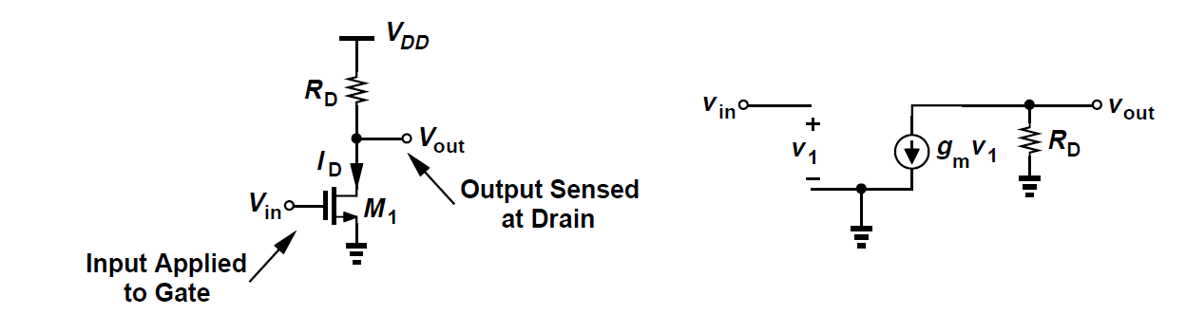
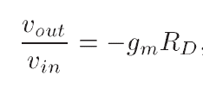


Common Source Amplifier

Slide 8
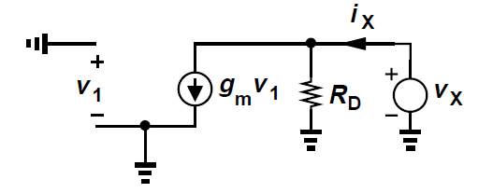
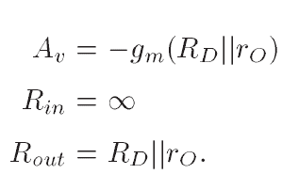
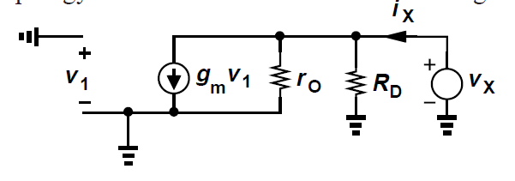
Common Source Amplifier
For large values of RD, the effect of channel-length modulation in M1 becomes significant

Slide 9
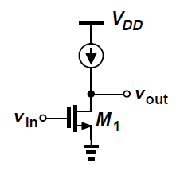
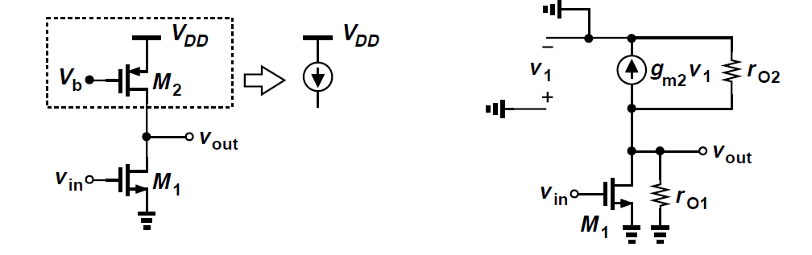
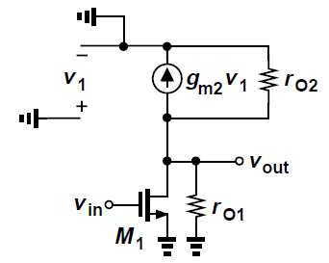

CS Amplifier: Current-Source Load
In applications requiring a large voltage gain in a single stage, the relationship A_{v} = −g_{m} R_{D} suggests that we should increase the load impedance of the CS stage. With a resistor or diode-connected load, however, increasing the load resistance translates to a large dc drop across the load, thereby limiting the output voltage swing.

Slide 10
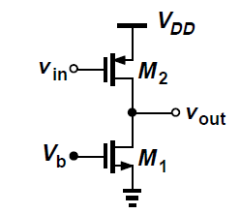

CS Amplifier: Active Load
The PMOS device serves as a constant current source
PMOS Amplifier
PMOS M2 to operate as an amplifying device

Slide 11
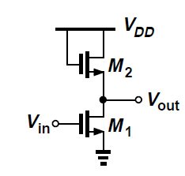
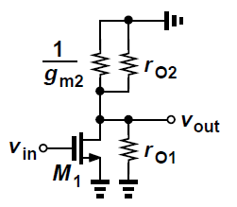


CS Amplifier: Diode Load
In some CMOS technologies, it is difficult to fabricate resistors with tightly controlled values or a reasonable physical size. Consequently, it is desirable to replace RD with a MOS transistor

Slide 12
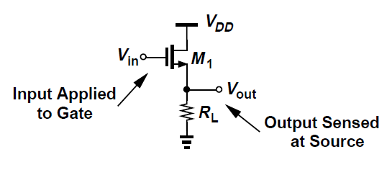
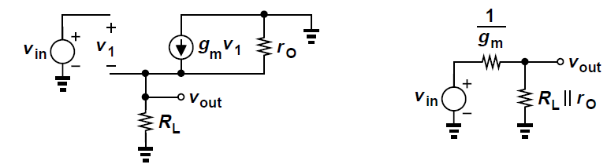
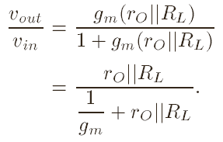

Source Follower

Slide 13
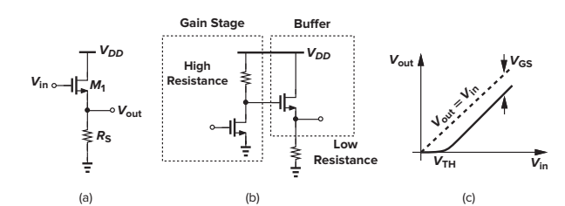
Source Follower: Application
Our analysis of the common-source stage indicates that, to achieve a high voltage gain with limited supply voltage, the load impedance must be as large as possible. If such a stage is to drive a low-impedance load, then a “buffer” must be placed after the amplifier so as to drive the load with negligible reduction in gain. The source follower (also called the “common-drain” stage) can operate as a voltage buffer.

Slide 14
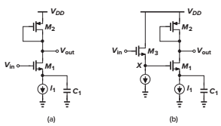
SF Biasing example (I)
(a) In the circuit of Fig. 3.47(a), calculate the voltage gain if C1 acts as an ac short at the frequency of interest. What is the maximum dc level of the input signal for which M1 remains saturated? (b) To accommodate an input dc level close to VDD, the circuit is modified as shown in Fig. 3.47(b). What relationship between the gate-source voltages of M2 and M3 guarantees that M1 is saturated?
Design of Analog CMOS Integrated Circuits Behzad Razavi
2nd Edition, page 74-75

Slide 15
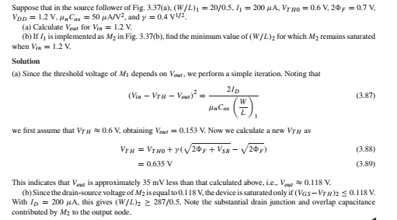
SF Biasing example (II)
Design of Analog CMOS Integrated Circuits Behzad Razavi
2nd Edition, page 69-70

Slide 16
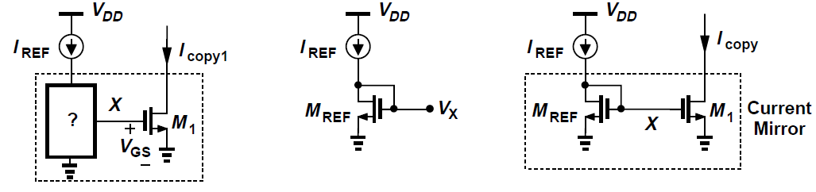


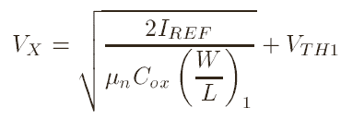
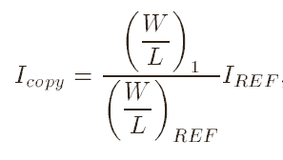
Current Mirror
M_{REF} is always in saturation

Slide 17
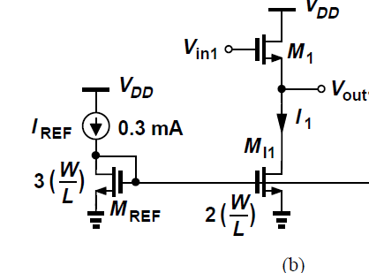
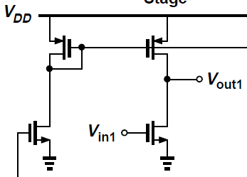
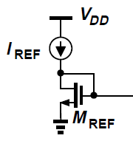
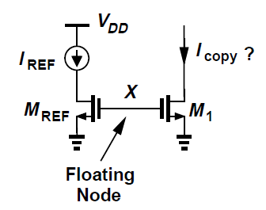
Current Mirror biasing
SF Amplifier
CS Amplifier
What happens here?
?
This circuit is not a current mirror because only a diode-connected device can establish and hence a copy current independent of device parameters and temperature. Since the gates of M_{REF} and M₁ are floating, they can assume any voltage, e.g., an initial condition created at node X when the power supply is turned on. In other words, I_{copy} is very poorly defined.

Slide 18
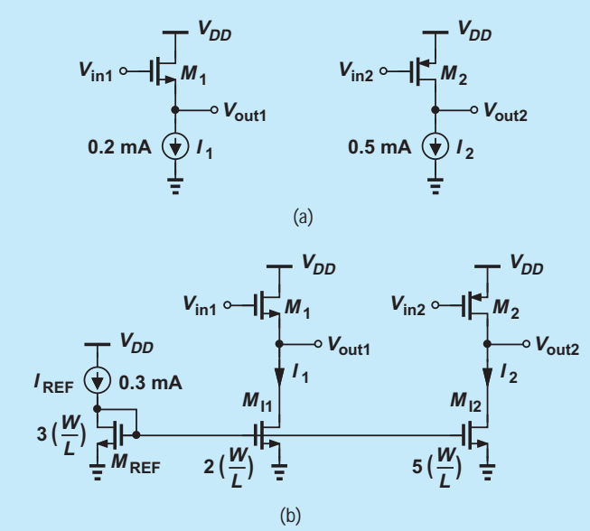
Current Mirror biasing
An integrated circuit employs the source follower and the common-source stage shown below. Design a current mirror that produces I1 and I2 from a 0.3-mA reference

Slide 19
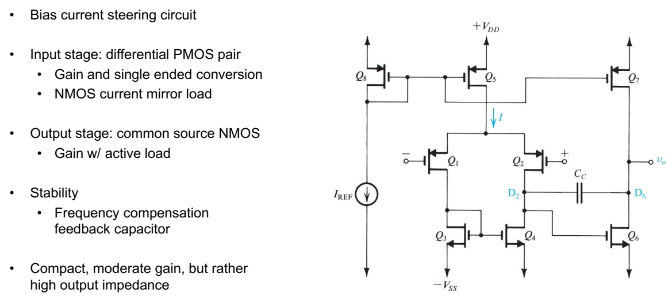
Two-Stage CMOS Op Amp

Slide 20
Two-Stage CMOS Op Amp
A reference bias current I REF is generated either externally or using on-chip circuits. The current mirror formed by Q8 and Q5 supplies the differential pair Q1-Q2 with bias current. The W/L ratio of Q5 is selected to yield the desired value for the input-stage bias current I (or I/2 for each of Q1 and Q2). The input differential pair is actively loaded with the current mirror formed by Q3 and Q4.
The second stage consists of Q₆, which is a common-source amplifier loaded with the current-source transistor Q₇. A capacitor C_{C} is included in the negative-feedback path of the second stage. Its function is for the frequency compensation.
The voltage gain of the first stage is to be given by:
where g_{m1} is the transconductance of each of the transistors of the first stage, that is, Q₁and Q₂.
The second stage is a current-source-loaded, common-source amplifier whose voltage gain is given by:
The dc open-loop gain of the op amp is the product of A₁ and A₂

Slide 21
Two-Stage CMOS Op Amp
Capacitor C_{c} and transistor Q_{c} (acting as a voltage controlled resistor) are included for Op-amp compensation to ensure stability when the Op-amp is used with feedback.
An active load realises a high-impedance load required for an amplifier. It replaces large resistors, or a large power supply voltage that would otherwise be required.

Slide 22
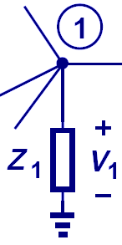
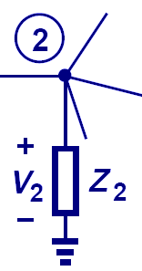
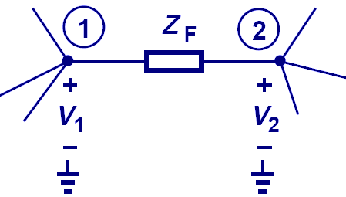
Miller’s Theorem
If A_{v} is the gain from node 1 to 2, then a floating impedance Z_{F} can be converted to two grounded impedances Z₁ and Z₂.

Slide 23
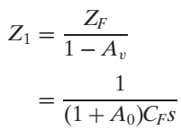
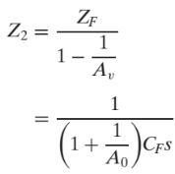
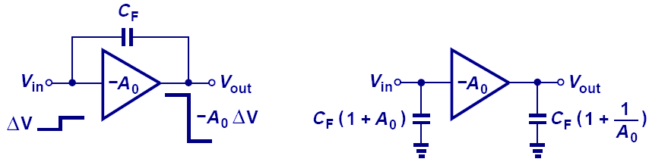
Miller Multiplication
With Miller’s theorem, we can separate the floating capacitor. However, the input capacitor is larger than the original floating capacitor. We call this Miller multiplication.

Slide 24
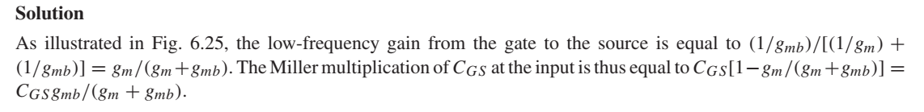
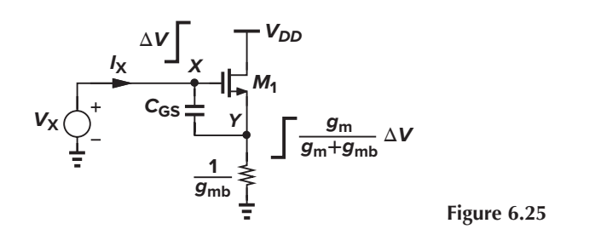
Miller Multiplication(example)
Design of Analog CMOS Integrated Circuits Behzad Razavi
2nd Edition, page 190.

Slide 25
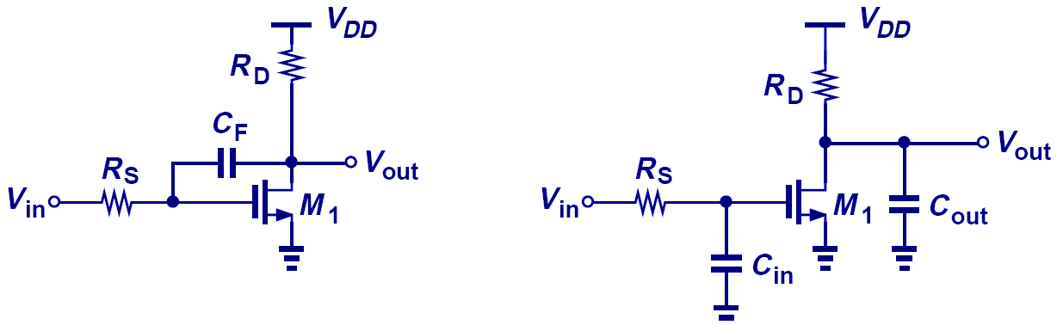
Example: Miller Theorem

Slide 26
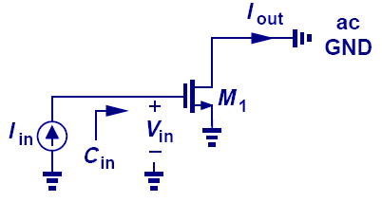

Transit Frequency Calculation
prove that:
Note that f_{T} increases with the overdrive voltage and the

Slide 27
Example: Transit Frequency Calculation
The minimum channel length of MOSFETs has been scaled from 1 μm in the late 1980s to 65 nm in 1990s. Also, the inevitable reduction of the supply voltage has reduced the gate-source overdrive voltage from about 400 mV to 100 mV. By what factor has the f_{T} of MOSFETs increased?
Solution:
It can be proved that Thus, the transit frequency has increased by approximately a factor of 59. For example, if μn = 400cm²/(V·s), then 65 nm devices having an overdrive of 100 mV exhibit an fT of 226 GHz.

Slide 28
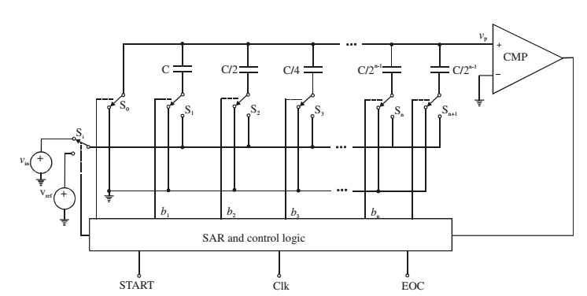
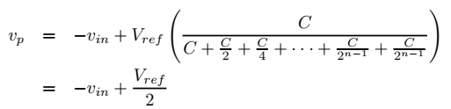



Charge-Redistribution ADCs
Its operation involves three cycles called the sample, hold, and redistribution cycles.
SAR: successive-approximation register

Slide 29
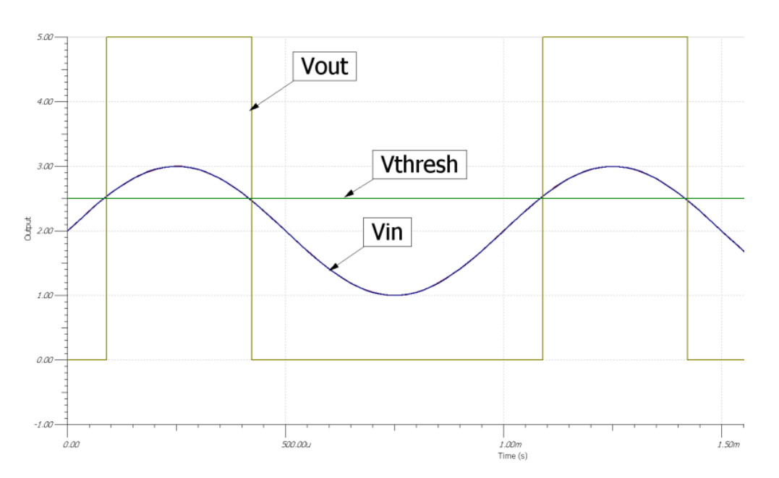
Charge-Redistribution ADCs(examples)
If the reference voltage V_{ref} = 8 V, what will be the voltage increment that will appear on the top plate when the switch corresponding to the least significant bit is switched
If the input voltage V_{in} = 3.5 V, which switches will be connected to V_{ref} at the end of the conversion?
Set b₁ = 1 (i.e. test with 100)
Therefore b₂ = 1
Set b₃ = 1 (i.e test with 011)
Therefore b₁ = 0
Set b₂ = 1 (i.e test with 010)
Therefore b₃ = 1
Switches S2 and S3 are connected to V_{ref} at the end of conversion.

Slide 30
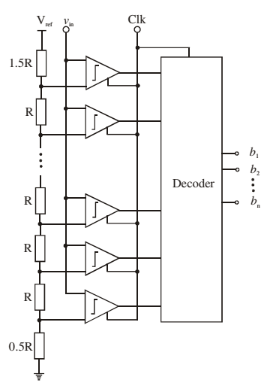
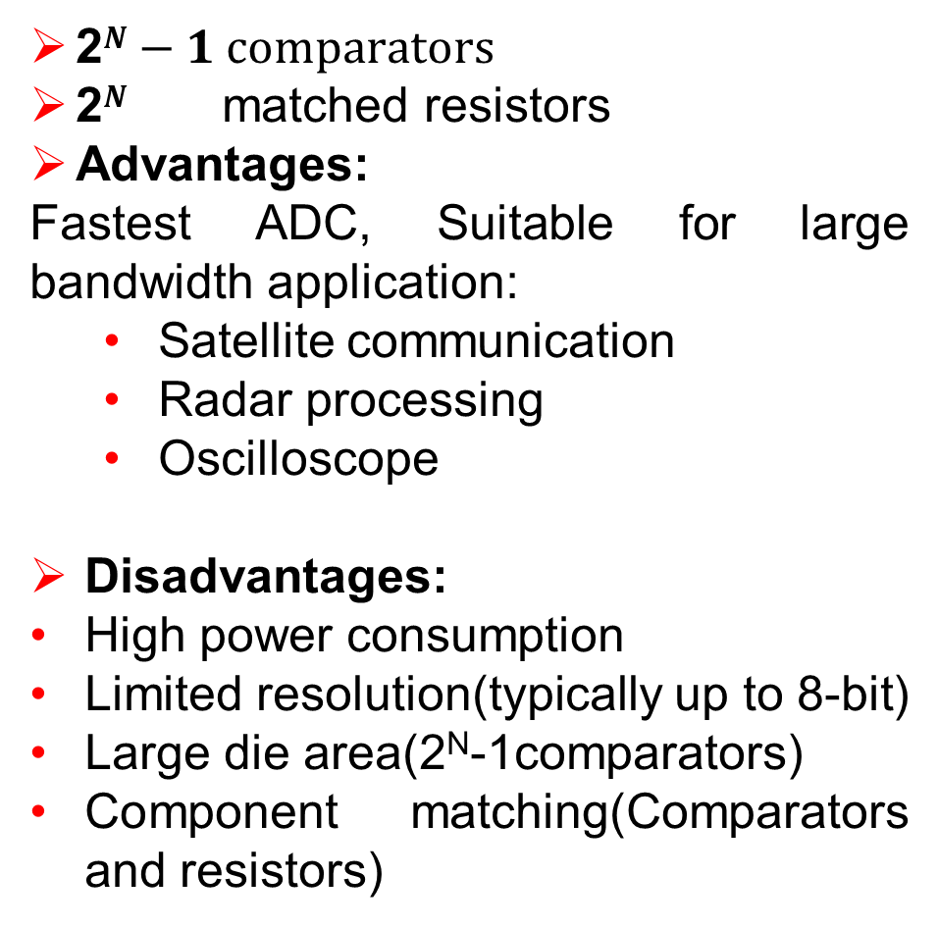
Flash Converters
2$N−1 comparators$
2$N$ matched resistors
Advantages:
Fastest ADC, Suitable for large bandwidth application:
Satellite communication
Radar processing
Oscilloscope
Disadvantages:
High power consumption
Limited resolution(typically up to 8-bit)
Large die area(2^{N}-1comparators)
Component matching(Comparators and resistors)

Slide 31
Flash Converters
A resistor string creates 7 reference levels. A bank of high speed latched comparators simultaneously compares V_{in} against each reference level. Since the input sampling and latching take place during the first phase of the clock period, and decoding during the second phase, the entire conversion takes only one clock cycle, so this ADC is the fastest possible.
If the reference voltage for the ADC is 4 V, specify the actual reference voltage levels used in the conversion process.

Slide 32
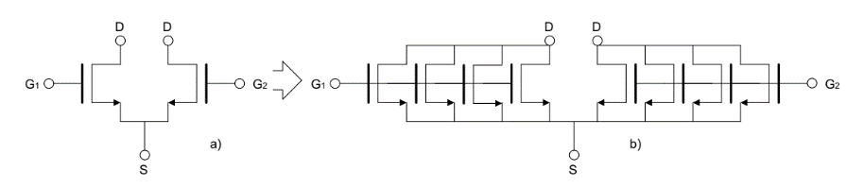
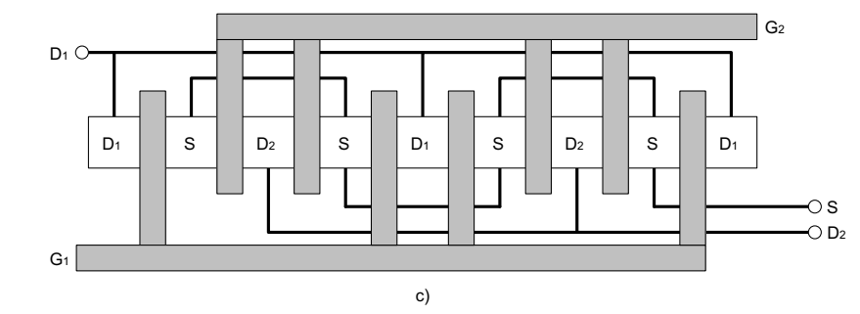
Common-centroid layout of a differential pair

Slide 33
Split of Transistors
Folded Cascode OPAMP
20
30
30
MP
2
3
3
M3
M4
M5
M6
6
6
60
60
M1
M2
5
5
40
40
80
80
M7
M8
38
3
3
MN
M11
M9
M10
2
2
16
16
25
24
24

Slide 34
Stack Design
555555344PP334666666
11221122112211221122
22112211221122112211
777779xxoo99nno88888
MP
M4
2
3
3
M3
M6
6
10x2
M5
6
M1
M2
5
5
M7
M8
MN
M11
M9
M10
2
2
3
3
X=11; o=10

Slide 35
Resistance thermal noise of multiple fingers(example)
Design of Analog CMOS Integrated Circuits Behzad Razavi
2nd Edition, page 737

Slide 36
Common Centroid Structures
C₁
C₂
C₃
C₄
C₅
TC₁
TC₂
TC₃
TC₄
TC₅
C₂ = C₁
C₃ = 2C₁
C₄ = 4C₁
C₅ = 8C₁
TC₅
TC₄
TC₁
TC₂
TC₃

Slide 37
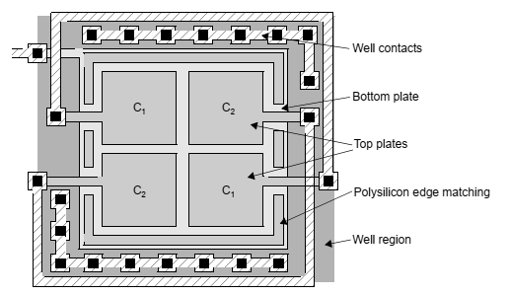
A simplified layout of a capacitor array

Slide 38

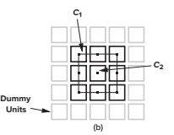
Common Centroid Structures(examples)
The circuit of Fig. 19.37(a) is designed for a nominal gain of C₁/C₂ = 8. How should C₁ and C₂ be laid out to ensure precise definition of the gain?
Behzad Razavi, “Design of Analog CMOS Integrated Circuits, 2nd Edition”, Chap. 19 Layout and Packaging, page 752.
Solution
We form C1 as 8 unit capacitors, each equal to C2, and place all of the units in a square array [Fig. 19.37(b)]. Note that (1) C₂ is symmetrically surrounded by the units comprising C₁ so that the effect of vertical or horizontal gradients is canceled to the first order; and (2) dummy capacitor units are placed around the main array, creating approximately the same environment for the units of C₁ as that seen by C₂.

Slide 39


Integrated Resistor Cross-section
A resistor is made of a strip of resistive layer.
ρ = resistivity (Ω*m)
R□ = sheet resistance (W/□)
□ is a dimensionless unit(!)
The endings resistance can be significant!

Slide 40

Diffusion/Well Resistors

Slide 41

Polysilicon Resistances
Conductive layers can be used to shield the conductor-oxide-
conductor structure

Slide 42
Interdigitized and Common Centroid
R1
R2
R2
R1
121212212121

